Slide 1
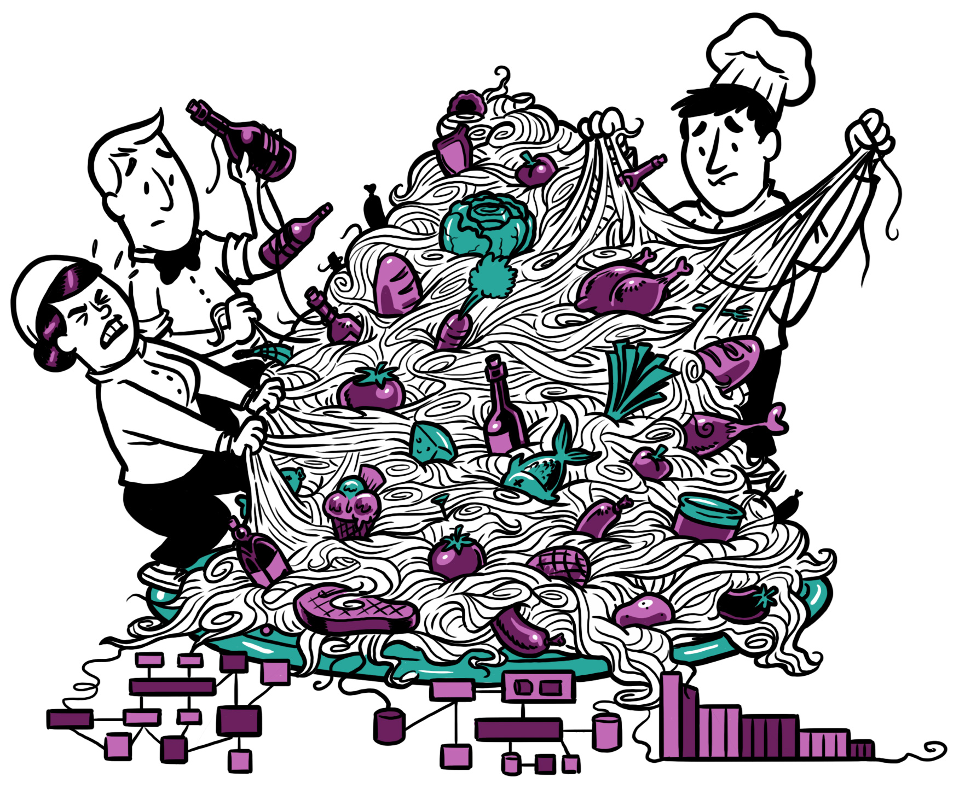
Dutch Devops Engineers Refactoring a Monolith to Microservices
Steven Ottenhoff, Marco van der Linden, Jan Vermeir

Slide 2
Programme
Welcome
Microservices, Bounded Context and ABC
Techniques for finding Microservices
Exercise 1: Break up the Shop
Exercise 2: Increase robustness
Exercise 3: From REST towards Events
Close
Notes:
IT architects. See what insights when taking a monolith and creating microservices. Design using several techniques, then developed a monolith, and broke this up.
Show some of the techniques, and show some aspects around integrating the services.

Slide 3


Introduction
Jan Vermeir
Steven Ottenhoff
Marco van der Linden

Slide 4

Introduction
Jan Vermeir
Bastiaan Bakker
Marco van der Linden

Slide 5
Microservices, Bounded Context and ABC

Slide 6
Microservices
Architectural style based on independently deployable and scalable services:
Each service provides a well-defined business capability
Communication through uniform, lightweight, interfaces
Allows independent development and maintenance
Allows independent installation and operation
Allows implementation in different technologies
Notes:
Example: Netflix. This approach is not for everyone. Has drawbacks:
Advantages
Smaller* services easier to develop, understand and maintain
Independence, so easier to change, install, replace
Service scaling specifically and independently
One team responsible for Dev and Ops
Robustness by distribution of services across landscape
Local choice of service implementation technology, fitting to character and requirements of service
Disadvantages
Distribution of logic introduces complexity in system
More services and more complex application introduces challenges for Operations
Diversity in technology requires knowledge/experience in more topics
Coordination between/across teams is crucial
Dependencies between services introduce delay in maintenance
Overhead network communication between distributed services

Slide 7
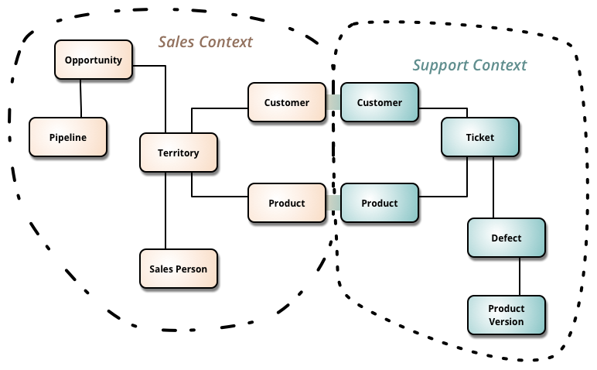
Bounded Context
Use of DDD concepts such as Domain and Bounded Context allow clean separation and identification of boundaries (interfaces)
“Bounded contexts are autonomous components, with their own domain models and their own ubiquitous language. They should not have any dependencies on each other at run time and should be capable of running in isolation. However they are a part of the same overall system and do need to exchange data with one another.”*
* https://msdn.microsoft.com/en-us/library/jj591572.aspx

Slide 8
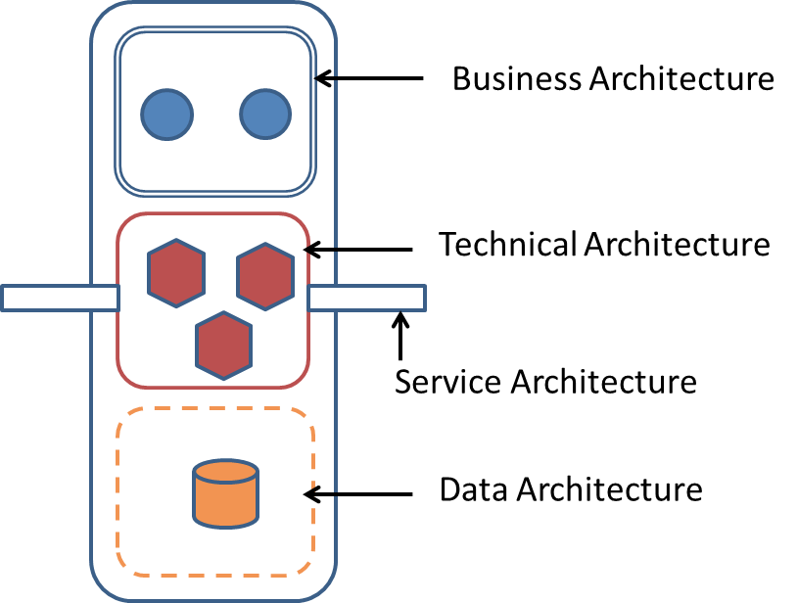
Autonomous Business Capability
Terminology from Roger Sessions’ Snowman Architecture. This approach can be used to simplify complex architectures.
Basic tenet: group together related functionality into autonomous components with explicit boundaries.
#Rule 1: Deep partitioning
#Rule 2: Data is private, information is shared
#Rule 3: Connect with async messages
#Rule 4: Transactions never cross boundaries
#Rule 5: Boundaries must be maintained
See http://simplearchitectures.blogspot.nl/2012/09/snowman-architecture-part-one-overview.html

Slide 9
Divide and conquer... and synchronize
Although autonomous, services will still need to exchange information
Some synchronization patterns (and their drawbacks):
Direct (synchronous) calls → requires simultaneous availability
Asynchronous calls → delayed consistency
Event publication → eventual consistency
Local cache of (remote) data → redundancy
There is no ‘best’ approach, it depends …

Slide 10
Architectural qualities Low Coupling
Measurement of dependency between two components
Expressed as sensitivity towards propagation of changes and errors
High Cohesion
Degree to which parts of a module belong together
http://en.wikipedia.org/wiki/Cohesion_%28computer_science%29
Notes:
Copied from agile architecture masterclass

Slide 11
Analysis techniques

Slide 12
Finding components through Visualization

Slide 13
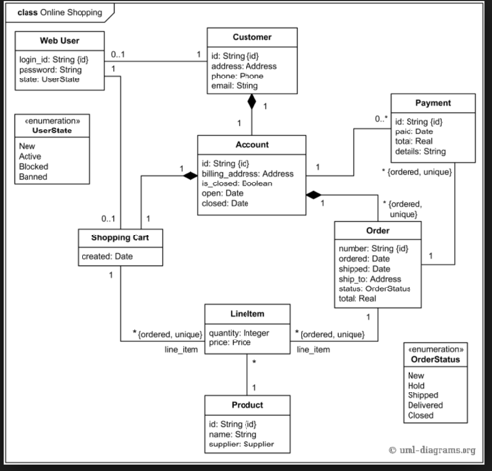
How to carve up this dinosaur?
Notes:
Use visualization to identify contexts / subdomains. Initially a visualization will show all the relations. Cut out tables such as User, or Audit tables …
This should show a grouping of tables that reflect contexts

Slide 14
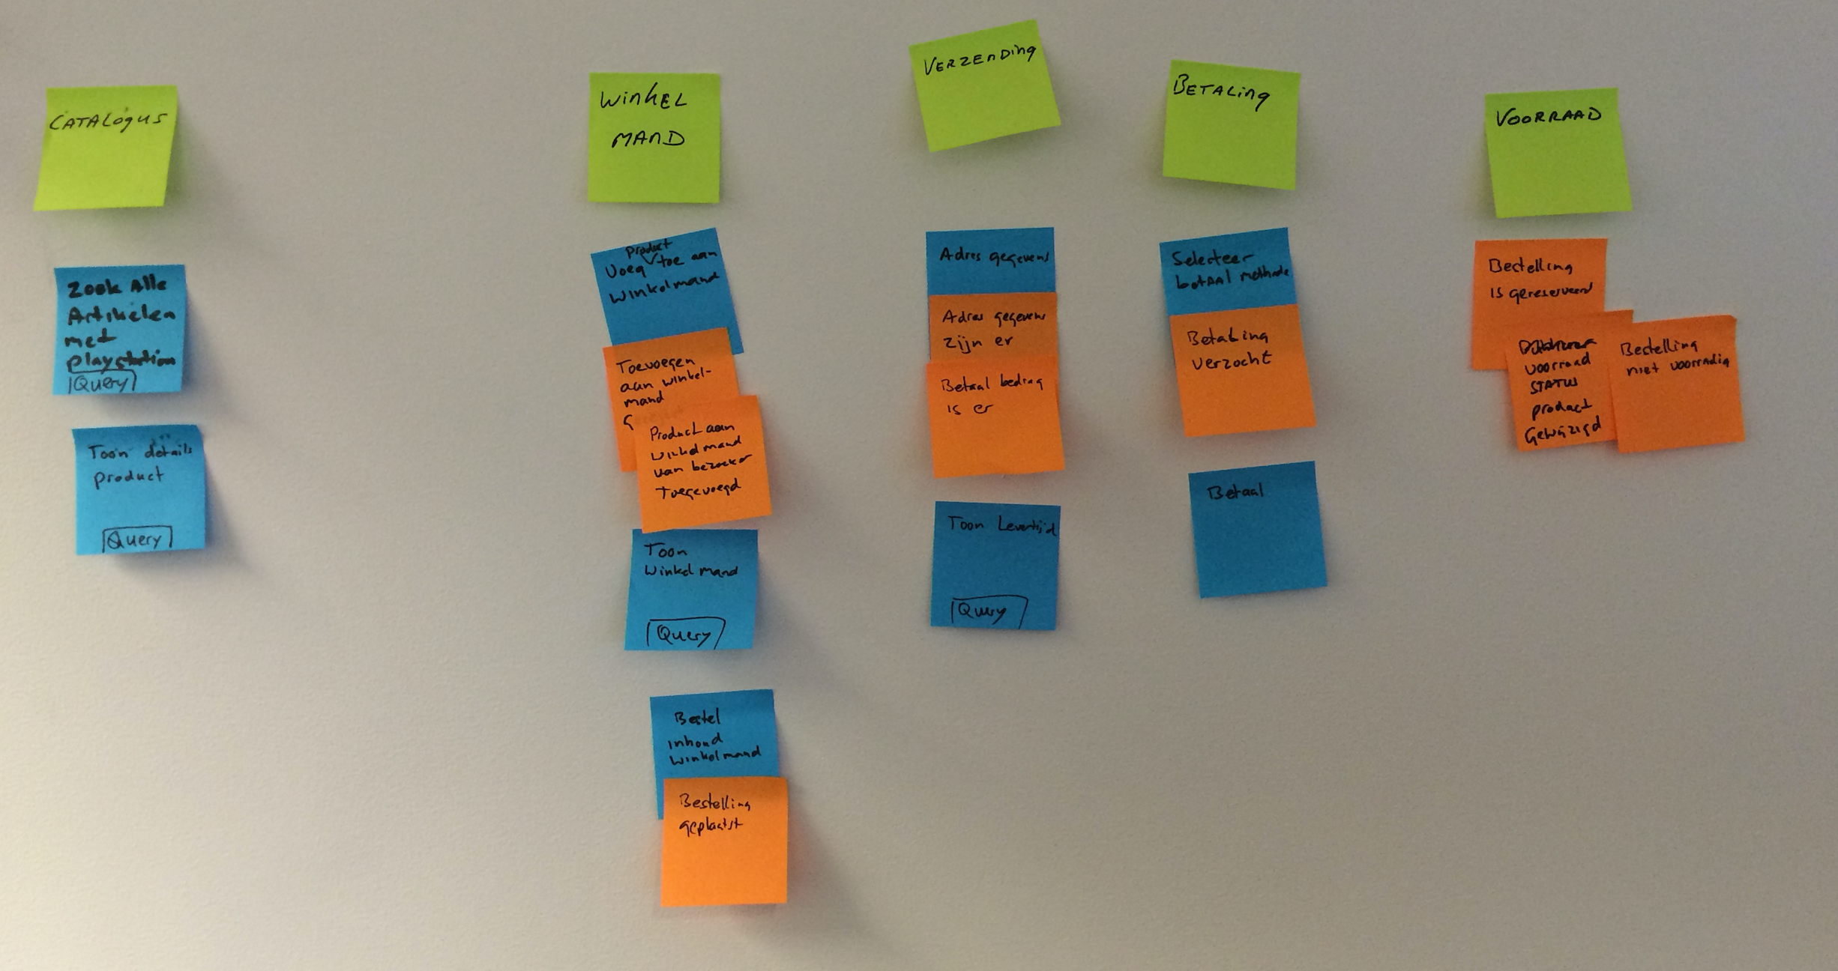
Event storming
workshop format for quickly exploring complex business domains
Identify domain events (orange)
Identify commands (blue)
Look for aggregates
Optional
Subdomains and contexts
User personas
Key acceptance tests
…
http://ziobrando.blogspot.nl/2013/11/introducing-event-storming.html
Notes:
There are a lot of methodologies that can be used to identify autonomous business capabilities / domains, and the boundaries between them.
One is event storming, used by Xebia at customer
Domain event is something meaningful that happened in the domain
Commands are found by following the origin of an event, like user action or external system
he Aggregate is the portion of the system that receives commands and decides whether to execute them or not, thus producing a domain event.

Slide 15
Simple Iterative Process
Two business functions A, B are synergistic if and only if, from the business perspective, A is not useful without B and B is not useful without A
Do this for all the functions
A partitioning will emerge which can be used to identify contexts
Notes:
Another approach is partitioning according to Roger Sessions. Quicker then Event Storming. For identifying high level functional domains (ABC) which can be transformed to micro services.
Eerst SIP (hoger abstractie niv, alleen groepering), dan ES (levert domein model met events en commands en actors).

Slide 16
Exercise 1: The “Shop”

Slide 17
Customer journey - Order products
Browse catalog
Add article to shopping cart
Checkout (create order)
Add shipping address
Submit Order
Perform Payment
Select delivery type
See delivery date
Notes:
MLI: This slide introduces the functionality of the webshop. No details of the solution should be given yet as the audience still needs to do an excercise

Slide 18

Exercise – break up the monolith
Goal of this exercise is to find out how a monolith can be broken up.
Form groups
Take 15 minutes and group the functions to identify services and their boundaries
What additional business functions can you think of ?
Notes:
Try to limit discussion to 10 minutes.

Slide 19
Business Functions
Add article to shopping cart
Select delivery type
Submit Order
Add shipping address
Cancel Order
Browse catalog
See delivery date
Checkout (create order)
Perform Payment with credit card
Add article
View Order
Perform Payment with invoice
Remove article from Shopping Cart
View Shopping Cart
Update article details
Notes:
MLI: This slide introduces the functionality of the webshop. No details of the solution should be given yet as the audience still needs to do an excercise

Slide 20
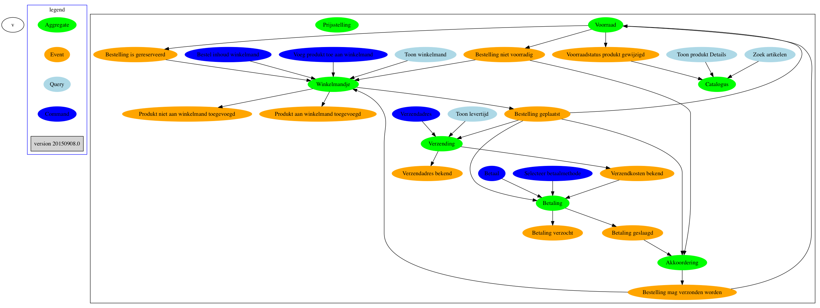
Event Storming results

Slide 21
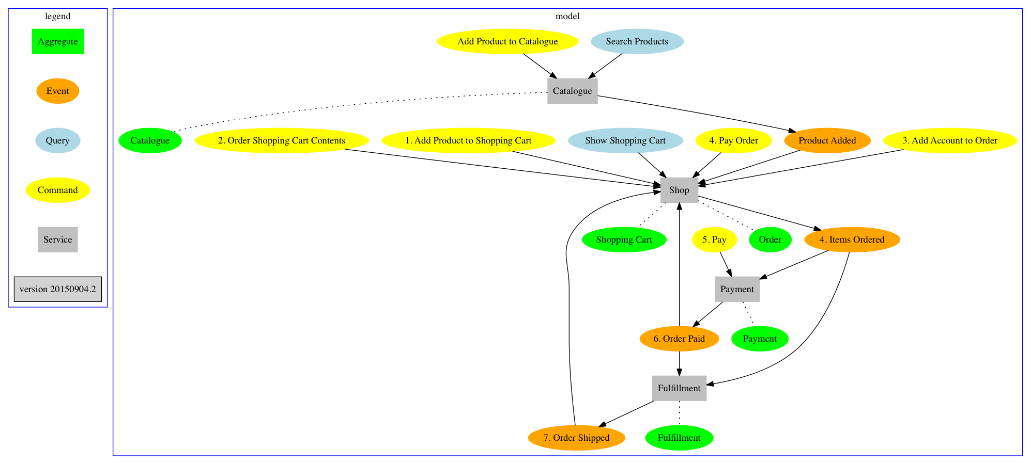
Shop: design with 4 services

Slide 22
Refactoring steps
For each service defined its (domain) model, and how to break up the monolithic database model
Extracted code from Shop to new Spring Boot applications: Payment, Fulfilments (Shipping) and Catalog
No real need to refactor package structure, but a lot of entities now appear in multiple services (for instance Order), but with different meaning and different fields
Most REST interfaces remain, but based on the design we add new interfaces for communication between services
Automated tests were added to allow testing of the customer journey across the services
There is now a lot more code, dependencies that were hidden in the monolith are now explicit. However, we now need to handle process to process communication.
In our first approach all services communicate via REST calls

Slide 23
Exercise 2
Increase robustness

Slide 24
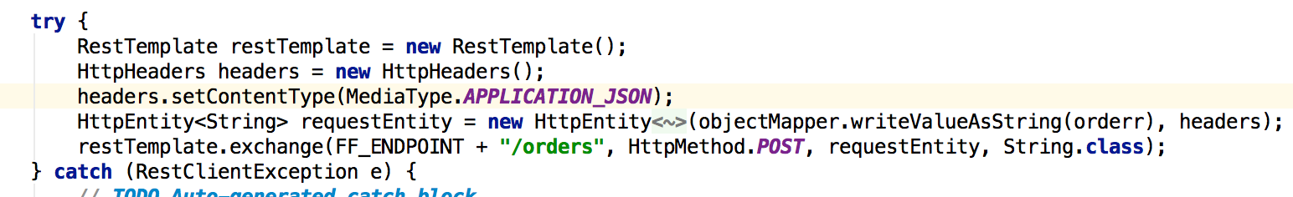
RESTful integration Shopping Cart with Shipping
Brittle, what happens if fulfilment service is slow or down?
How can we improve this?
http://blog.xebia.com/2015/03/18/microservices-coupling-vs-autonomy/

Slide 25
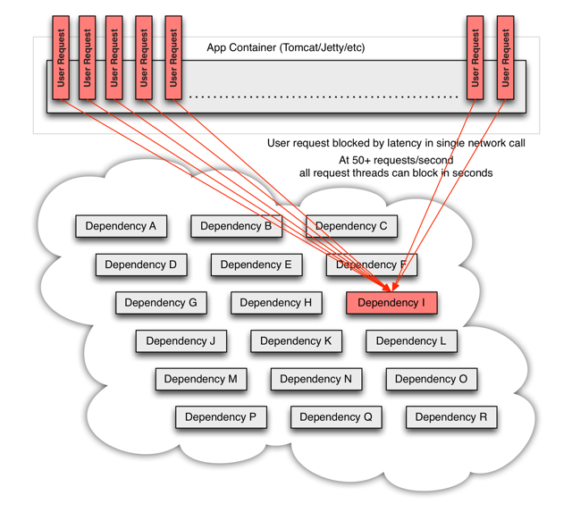
Circuit breaker pattern
“Hystrix is a latency and fault tolerance library designed to isolate points of access to remote systems, services and 3rd party libraries, stop cascading failure and enable resilience in complex distributed systems where failure is inevitable”
Hystrix is a library that implements the circuit breaker pattern and provides:
Timeouts
Fallbacks
Monitoring of failures and successful calls.
Allows graceful degradation, Retries, Fail Over or Fail Fast
https://github.com/Netflix/Hystrix
http://martinfowler.com/bliki/CircuitBreaker.html

Slide 26
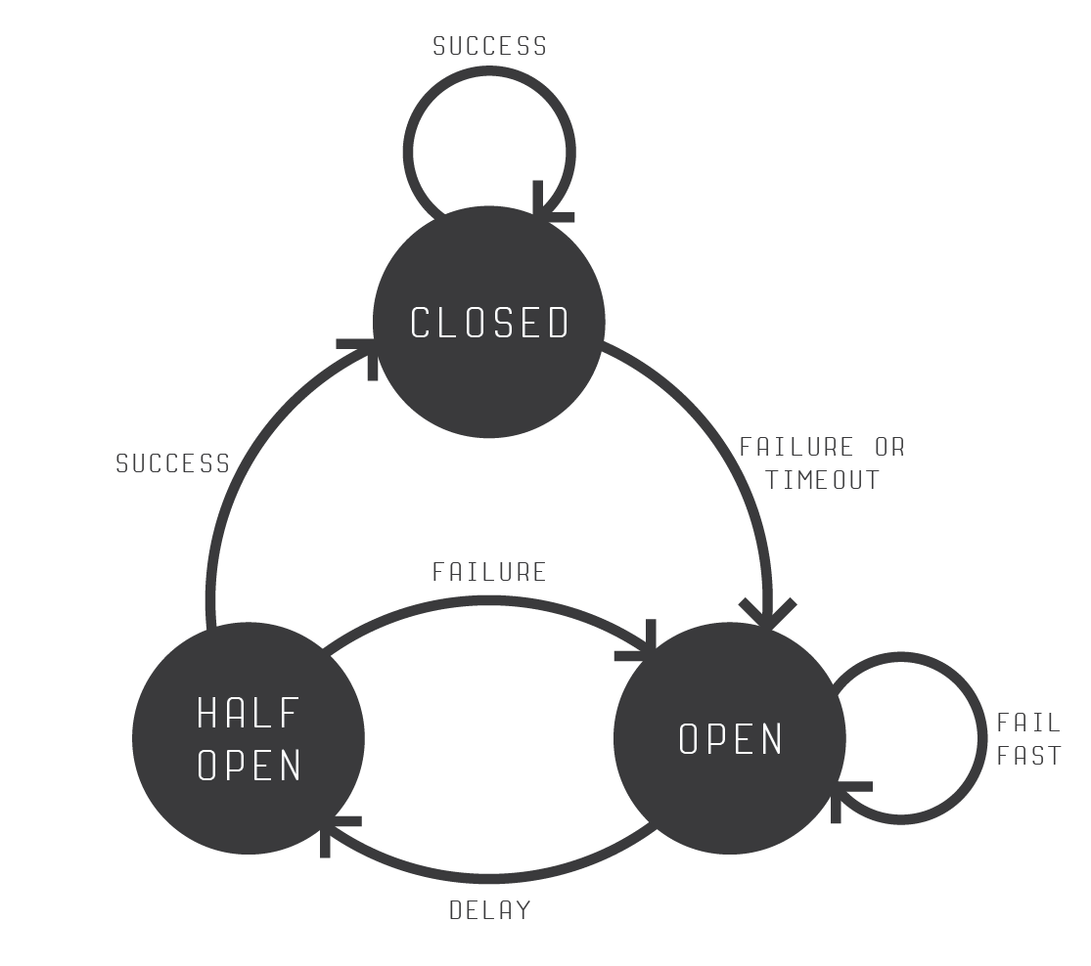
Increase robustness
In order to be able to do this exercise you must clone the following GitHub repository:
The exercise is described in git repo/exercise-circuitbreaker2/readme.md
The goal is to implement a circuit breaker
Time limit for this exercise is 30 minutes
Use https://github.com/Netflix/Hystrix to get familiar with circuit breakers.
git clone https://github.com/xebia/microservices-breaking-up-a-monolith.git
http://bartoszsypytkowski.com/design-patterns-circuit-breaker/

Slide 27
Exercise 3
From REST towards Events

Slide 28
From REST towards events
In order to be able to do this exercise you must clone the following GitHub repository and follow the instructions described in the readme.md file.
The exercise is described in git repo – src/exercise-queues/readme.md
The goal is to implement integration using messages
Time limit for this exercise is 30 minutes
git clone https://github.com/xebia/microservices-breaking-up-a-monolith.git

Slide 29
Things we will explore next
We found that, already with only a couple of services, overview (who calls whom) becomes an issue. We also found that integrated testing of the services needs a better approach.
So for the next iteration we will:
Add a testing framework
Add a monitoring solution that uses the metrics and logs
Add Consul or similar
Look at a standardized format for the events
Run load tests
Add security
Run on a platform (Docker?)

Slide 30
Evaluation
What was cool..
What can be improved..
Please put a sticky on the whiteboard.

Slide 31
Thank you for your participation!

Slide 32
Extra slides

Slide 33
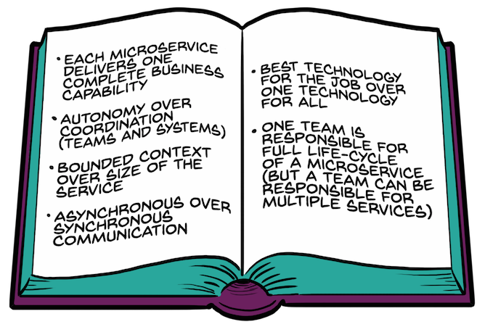
Things to take away

Slide 34
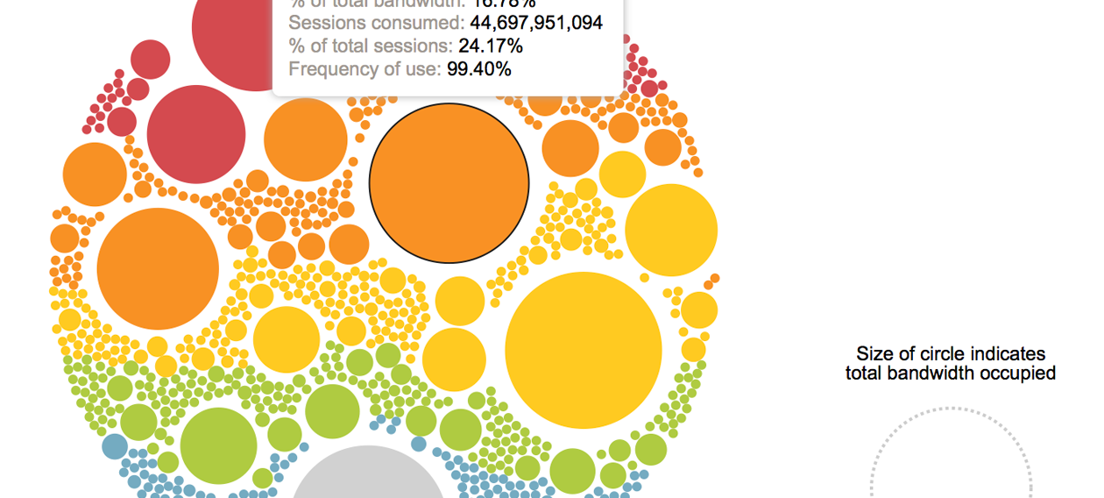
Visualization
Visualization of relationships

Slide 35
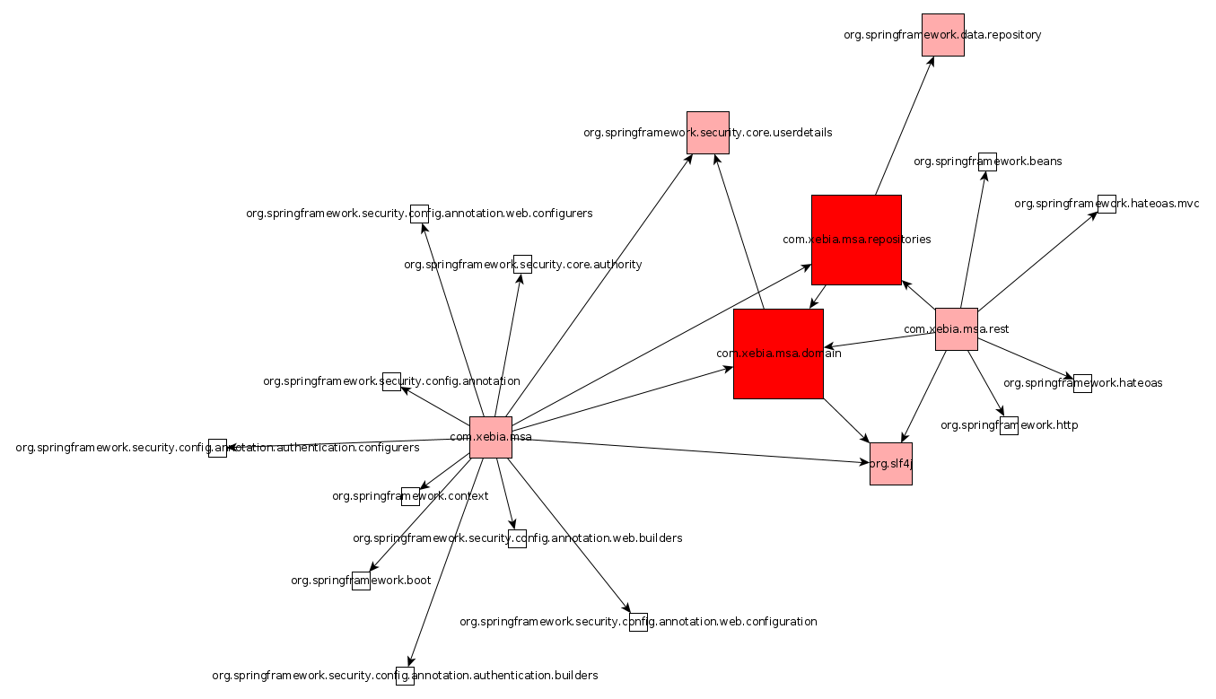
Package Dependencies
Notes:
Micro A Monolith. Logical Cohesion of domain and repositories packages. Generated with jdepend, jdepend2tgf and yed.

Slide 36
Foreign Key Constraints (1)
CREATE TABLE `patient`
…
ALTER TABLE `patient_allergies`
ADD CONSTRAINT `patient_allergies_ibfk_1` FOREIGN KEY (`PATIENT_ID`) REFERENCES `patient` (`PATIENT_ID`),
ADD CONSTRAINT `patient_allergies_ibfk_2` FOREIGN KEY (`ALLERGY_CODE`) REFERENCES `allergies` (`ALLERGIES_CODE`);
Notes:
Extracting foreign key constraints is sufficient get much information on the structure and dependencies in the domain.

Slide 37
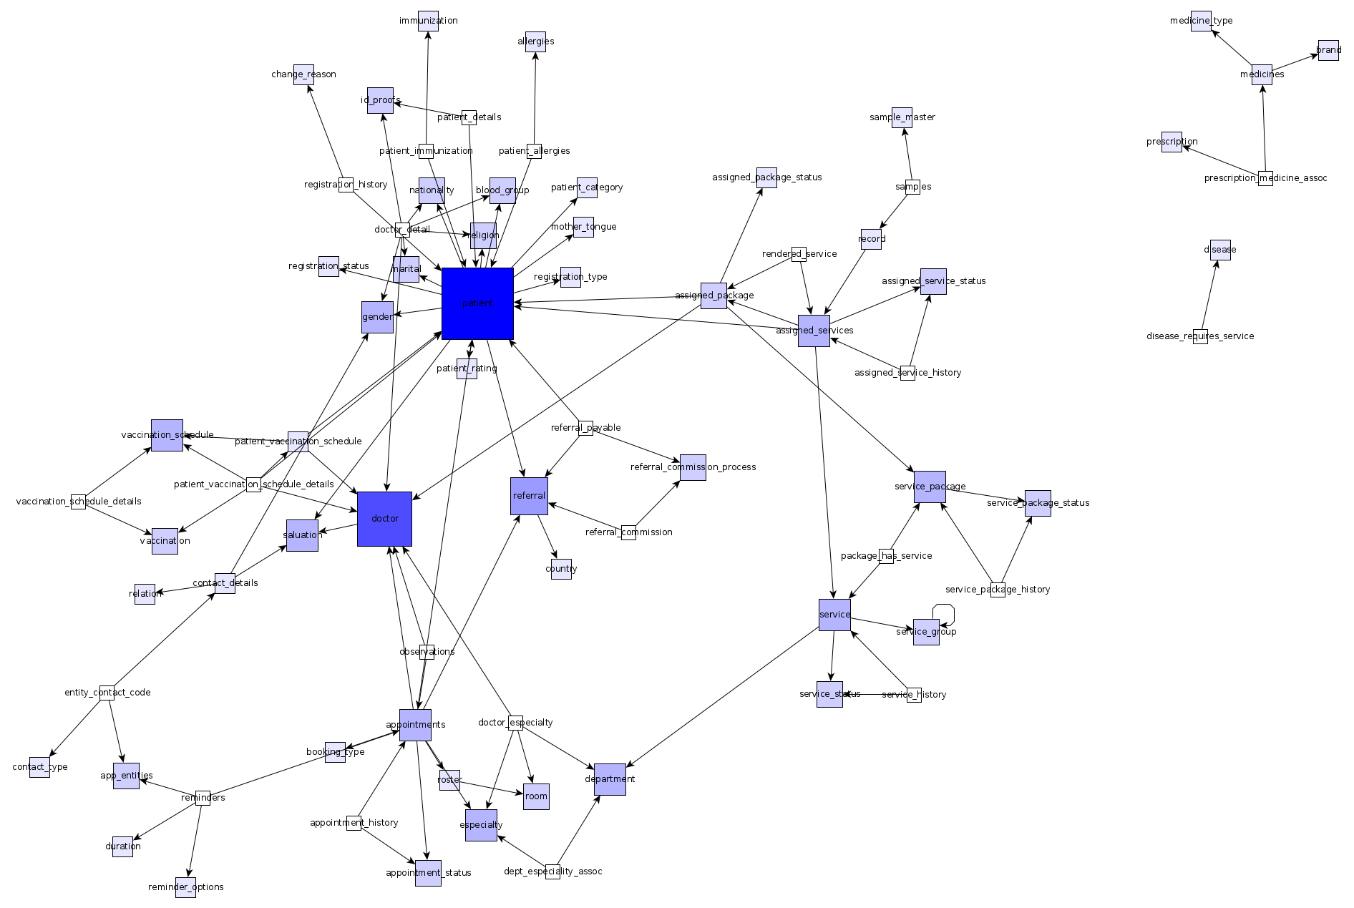
Foreign Key Constraints (2)
https://github.com/walkingtree/hcis/blob/master/Sql/hcis_core_schema.sql

Slide 38
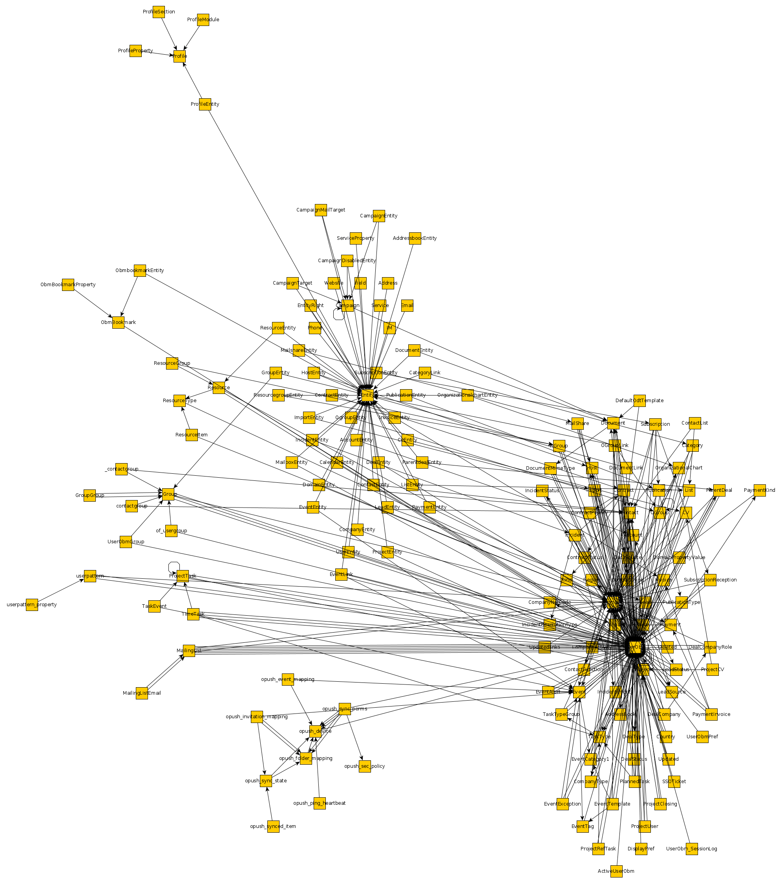
Foreign Key Constraints (3)
https://github.com/mbaechler/OBM/blob/master/ui/scripts/2.4/create_obmdb_2.4.mysql.sql
Notes:
Db van obm.org

Slide 39
On dependencies between services
Different kinds of dependencies:
At develop-time: designing and implementing functionality
At compile-time: building executable services
At run-time: delivering business functionality in customer journeys
Microservices architecture primarily addresses the first two
Independent development of business capabilities
Isolated deployment of business services
But on customer journey-level, dependencies might remain
Customer journeys integrate multiple business capabilities
Notes:
BB: a bit of disagreement here: microservices do help to eliminate runtime dependency. By having the right service boundaries it is easier to swap implementations at runtime, e.g. to perform graceful degradation of services. Example: replace full product search with a simple one, replace simple product search with static top-10 product page, replace shopping cart with single item checkout ('one click purchase' feature ;-) . So it is much easier to replace the 'full' customer journey with a simpler one if the full one is not available / performant, etc.

